Slide 1

FFT and Integer Multiplication
By Michael Needleman
Notes:
2nd video in the post-quantum cryptography series
FFT is a key component in some quantum algorithms

Slide 2





Motivation
Every integer can be represented as a polynomial
Simple multiplication of polynomials (and integers) of degree n takes $O(n^{2})$ time
We can do better!
$$A\left(x\right)=\sum_{j=0}^{n−1}{a_{j}x^{j}}$$
$$C\left(x\right)= \sum_{j=0}^{2n−2}{c_{j}x^{j}}$$
$$B\left(x\right)= \sum_{j=0}^{n−1}{b_{j}x^{j}}$$
$$c_{j}= \sum_{k=0}^{j}{a_{k}b_{j−k}}$$
Notes:
- For large numbers, simple multiplication is very expensive

Slide 3



Coefficient Representation
$$A\left(x\right)=\sum_{j=0}^{n−1}{a_{j}x^{j}}$$
Allows for O(n) evaluation using Horner’s method:
$A(x_{0}) = a_{0} + x_{0}(a_{1}+ x_{0}(a_{2} + … + x_{0}(a_{n}−1))…)$
Addition is O(n) as well
$c_{j} = a_{j} + b_{j} for j=0…n−1$
Multiplication is more expensive
Each coefficient must be multiplied by every other, $O(n^{2})$
$$B\left(x\right)= \sum_{j=0}^{n−1}{b_{j}x^{j}}$$
Notes:
We can represent numbers as polynomials
While we don’t often think about it, it’s the basis of our decimal number system
Coefficient representation doesn’t quite solve the multiplication problem

Slide 4

Coefficient Representation Example
Base 10: 12345 = $5∗{10}^{0}+ 4∗{10}^{1} + 3∗{10}^{2} + 2∗{10}^{3} + 1∗{10}^{4}$
= $5 + 4x + 3x^{2}+ 2x^{3}+ x^{4 }where x=10$
Base 2: $13={1101}_{2} = 1∗2^{0}+ 0∗2^{1}+ 1∗2^{2}+ 1∗2^{3}$
= $1 + 0x + x^{2}+ x^{3}$
Notes:
Twelve-thousand, three hundred and forty-five

Slide 5
Point-Value Representation
$A(x) = \{(x_{0},y_{0}), (x_{1},y_{1}), …, (x_{n−1}, y_{n−1})\}$
𝐴(𝑥) = {(𝑥_0,𝑦_0), (𝑥_1,𝑦_1), …, (𝑥_(𝑛−1), 𝑦_(𝑛−1))}
such that:
All x are distinct
$$y_{k} = A(x_{k}) for k=0,1,…,n−1$$
𝑦_𝑘 = 𝐴(𝑥_𝑘) 𝑓𝑜𝑟 𝑘=0,1,…,𝑛−1
Conversion from coefficient form to point-value is inexpensive
Choose n points $x_{0},x_{1},…x_{n−1}$then evaluate at $A(x_{k}) for k=0,1,…,n−1$
Choose n points 𝑥_0,𝑥_1,…𝑥_(𝑛−1) then evaluate at 𝐴(𝑥_𝑘) 𝑓𝑜𝑟 𝑘=0,1,…,𝑛−1
With Horner’s method, evaluation takes $O(n^{2})$
With Horner’s method, evaluation takes 𝑂(𝑛^2)
Notes:
For a given polynomial, we can evaluate it at n distinct points to form the point-value representation

Slide 6
Conversion from Coefficient Form to Point-Value Form
Choose x={1,2,3,4,5,6,7,8,9,10}
We get a point-value representation of: {(1,15),(2,57),(3,179),(4,453),(5,975),(6,1865),(7,3267),(8,5349),(9,8303),(10,12345)}
Notes:
Looking back at our original example, we convert the number 12345 into the polynomial.
Then, selecting ten points, I get the point-value representation formed by the set {(1,15), (2,57), etc}

Slide 7
Perks of Point-Value Representation
***Effective choice of points xk allows for conversion in $O(n logn)$***
***Effective choice of points xk allows for conversion in 𝑂(𝑛 𝑙𝑜𝑔𝑛)***
Inverse of evaluation, interpolation, always yields a unique polynomial
Can be done in $O\left(n^{2}\right)$ time using Lagrane’s formula
Can be done in 𝑂(𝑛^2 ) time using Lagrane’s formula
Addition is still O(n):
$$c_{k} = a_{k} + b_{k}$$
𝑐_𝑘 = 𝑎_𝑘 + 𝑏_𝑘
Multiplication is now O(n)*:
$$c_{k} = a_{k} ∗ b_{k}$$
𝑐_𝑘 = 𝑎_𝑘 ∗ 𝑏_𝑘
Notes:
Why is point-value useful?
If I pick the right points, I can form the point-value representation in O(n log n)
Multiplication is O(n)! Even with the conversion, it’s faster than simple multiplication
Simple interpolation is expensive, but can be improved

Slide 8

Simple Symmetry: $A\left(x\right) = x^{4}$
For degree n:
When n is even, A(x) = A(-x)
When n is odd, A(x) = -A(-x)
Notes:
For simple polynomials, there is symmetry about the y axis.

Slide 9








Roots of Unity
Goal: We need some function f(x) that:
Is symmetric f(x) = -f(-x)
Holds for $f\left(\sqrt[2]{x}\right)=f\left(\sqrt[2]{x}\right)$
Enter the complex nth roots of unity: $ω_{n}=e^{\frac{2iπk}{n}}$
Useful properties:
$w_{n}^{n}=1$
Halving Lemma
Cancellation Lemma
Summation Lemma
$$x=1$$
$$x=−1$$
$$x=i$$
$$x=−i$$
$$x^{2}=1$$
$$x^{2}=−1$$
$$x^{4}=1$$
Notes:
Halving Lemma: squares of the nth roots of unity are the n/2 roots of unity

Slide 10

Formal Definition of the DFT
$$y_{k}=A\left(ω_{n}^{k}\right)= \sum_{j=0}^{n−1}{a_{j}ω_{n}^{kj}}$$

Slide 11

How to Evaluate Quickly
Can split polynomial into even and odd terms
$A(x) = A_{e}(x) + xA_{o}\left(x\right)$
Example Recursive splitting of A = 12345, padded to A = 00012345
$$A(x) = 5 + 4x + 3x^{2} + 2x^{3} + 1x^{4} + 0x^{5} + 0x^{6} + 0x^{7}$$
$$= A_{e}(x^{2}) + xA_{o}(x^{2})$$
Notes:
Speeding up the DFT to form the FFT
We can take our A=12345 and convert it into a sum of coefficients and powers.
With a little reordering, it can be organized into even and odd terms. But the even terms are just the odd terms with an extra x attached, so that can be pulled out.

Slide 12


How to Evaluate Quickly
Can split polynomial into even and odd terms
$A(x) = A_{e}(x) + xA_{o}\left(x\right)$
Example Recursive splitting of A = 12345, padded to A = 00012345
$$A(x) = 5 + 4x + 3x^{2} + 2x^{3} + 1x^{4} + 0x^{5} + 0x^{6} + 0x^{7}$$
$$= A_{e}(x^{2}) + xA_{o}(x^{2})$$
$$A_{e}\left(x\right) = 5 + 3x + 1x^{2} + 0x^{3}$$
$$= A_{ee}\left(x^{2}\right) + xA_{eo}\left(x^{2}\right)$$
$$A_{o}\left(x\right) = 4 + 2x + 0x^2 + 0x^{3}$$
$$= A_{oe}\left(x^{2}\right) + xA_{oo}\left(x^{2}\right)$$
Notes:
We can take our A=12345 and convert it into a sum of coefficients and powers.
With a little reordering, it can be organized into even and odd terms. But the even terms are just the odd terms with an extra x attached, so that can be pulled out.

Slide 13


How to Evaluate Quickly
Can split polynomial into even and odd terms
$A(x) = A_{e}(x) + xA_{o}\left(x\right)$
Example Recursive splitting of A = 12345, padded to A = 00012345
$$A(x) = 5 + 4x + 3x^{2} + 2x^{3} + 1x^{4} + 0x^{5} + 0x^{6} + 0x^{7}$$
$$= A_{e}(x^{2}) + xA_{o}(x^{2})$$
$$A_{e}\left(x\right) = 5 + 3x + 1x^{2} + 0x^{3}$$
$$= A_{ee}\left(x^{2}\right) + xA_{eo}\left(x^{2}\right)$$
$$A_{o}\left(x\right) = 4 + 2x + 0x^2 + 0x^{3}$$
$$= A_{oe}\left(x^{2}\right) + xA_{oo}\left(x^{2}\right)$$
$$A_{ee}\left(x\right) = 5 + 1x$$
$$= A_{eee}\left(x^{2}\right) + xA_{eeo}\left(x^{2}\right)$$
$$A_{eo}\left(x\right) = 3 + 0x$$
$$=A_{eoe}\left(x^{2}\right) + xA_{eoo}\left(x^{2}\right)$$
Aoe(x) = 4 + 0x
= Aoee(x^2) + xAoeo(x^2)
Aoo(x) = 2 + 0x
= Aooe(x^2) + xAooo(x^2)
Notes:
We can take our A=12345 and convert it into a sum of coefficients and powers.
With a little reordering, it can be organized into even and odd terms. But the even terms are just the odd terms with an extra x attached, so that can be pulled out.

Slide 14








How to Evaluate Quickly
Can split polynomial into even and odd terms
$A(x) = A_{e}(x) + xA_{o}\left(x\right)$
Example Recursive splitting of A = 12345, padded to A = 00012345
$$A(x) = 5 + 4x + 3x^{2} + 2x^{3} + 1x^{4} + 0x^{5} + 0x^{6} + 0x^{7}$$
$$= A_{e}(x^{2}) + xA_{o}(x^{2})$$
$$A_{e}\left(x\right) = 5 + 3x + 1x^{2} + 0x^{3}$$
$$= A_{ee}\left(x^{2}\right) + xA_{eo}\left(x^{2}\right)$$
$$A_{o}\left(x\right) = 4 + 2x + 0x^2 + 0x^{3}$$
$$= A_{oe}\left(x^{2}\right) + xA_{oo}\left(x^{2}\right)$$
$$A_{ee}\left(x\right) = 5 + 1x$$
$$= A_{eee}\left(x^{2}\right) + xA_{eeo}\left(x^{2}\right)$$
$$A_{eo}\left(x\right) = 3 + 0x$$
$$=A_{eoe}\left(x^{2}\right) + xA_{eoo}\left(x^{2}\right)$$
Aoe(x) = 4 + 0x
= Aoee(x^2) + xAoeo(x^2)
Aoo(x) = 2 + 0x
= Aooe(x^2) + xAooo(x^2)
$$A_{eee}\left(x\right)=5$$
$$A_{eeo}\left(x\right)=1$$
$$A_{eoe}\left(x\right)=3$$
$$A_{eoo}\left(x\right)=0$$
$$A_{oee}\left(x\right)=4$$
$$A_{oeo}\left(x\right)=0$$
$$A_{ooe}\left(x\right)=2$$
$$A_{ooo}\left(x\right)=0$$
Notes:
We can take our A=12345 and convert it into a sum of coefficients and powers.
With a little reordering, it can be organized into even and odd terms. But the even terms are just the odd terms with an extra x attached, so that can be pulled out.

Slide 15

How to Choose Effective Points
Can split polynomial into even and odd terms
A(x) = $A_{e}\left(x\right) + xA_{o}\left(x\right)$
Take advantage of symmetries in functions
For degree n:
When n is even, A(x) = A(-x)
When n is odd, A(x) = -A(-x)
By expanding into the complex domain, both facts remain true for recursive definitions of A(x)
Nth roots of unity fulfill both criteria! $ω_{n}=e^{\frac{2iπ}{n}}$

Slide 16

Conversion from Point-Value Back to Coefficient Representation
Interpolation is well defined, and is based on the existence of the Vandermonde matrix
We can use the matrix, generated by the nth roots of unity, and invert it to find the new coefficients
Replace $ω_{n} with ω_{n}^{−1}$, swap a and y, and divide by n
$a_{j}=\frac{1}{n}\sum_{k=0}^{n−1}{y_{k}ω_{n}^{−kj}}$

Slide 17
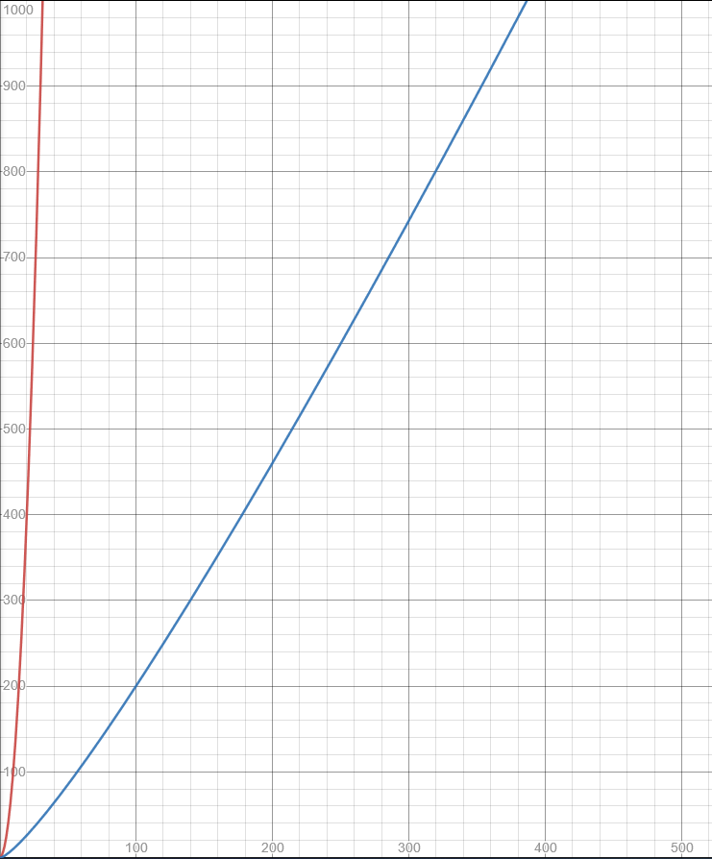

Putting It All Together
Create coefficient forms of degree-bound 2n
Convert from coefficient form to point-value form (using complex nth roots of unity)
Perform pointwise multiplication
Convert back to coefficient form
Red:
Ordinary Multiplication $O\left(n^{2}\right)$
Blue:
Efficient Multiplication $O\left(n\log{n}\right)$

